Slide 1
WELLCOME

Slide 2
Project report of
Gym Management
Submitted By:-
Tejash.Jagganath.Mhatre
Ashish.Chandrakant.Chavan
Under Valuable Guidance of
Mr. Rohan Gosalkar (Sir).

Slide 3
Introduction to Project
This Project is specially designed by keeping Body Building Gyms in mind.
It uses ASP.NET as basic programming language.
It maintains every single record with reliability.
It uses Microsoft Access as the database.

Slide 4
Project Objectives
To develop a application-based portal to facilitate more co-ordination between customers and the manager.
To reduce hectic paper work & thus reduce workload.
To provide proper security for stored data.
To reduce paperwork related costs.

Slide 5


Slide 6
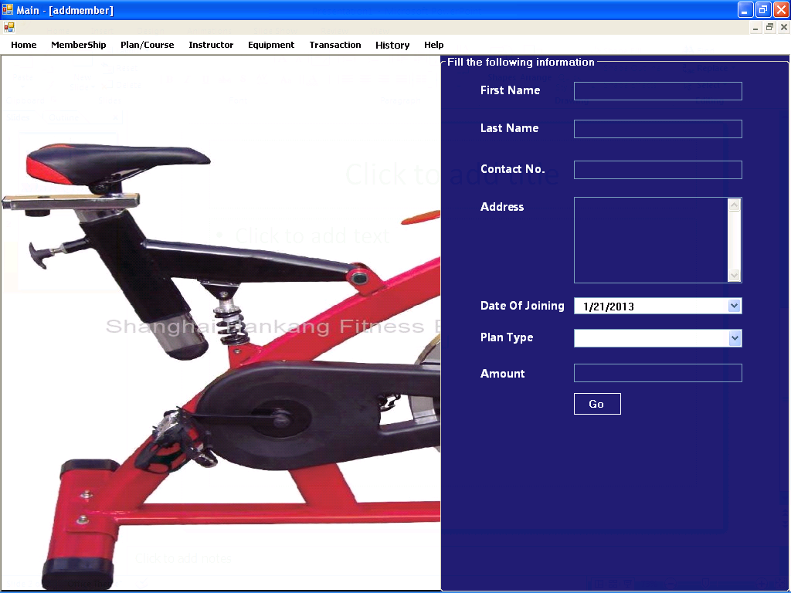

Slide 7
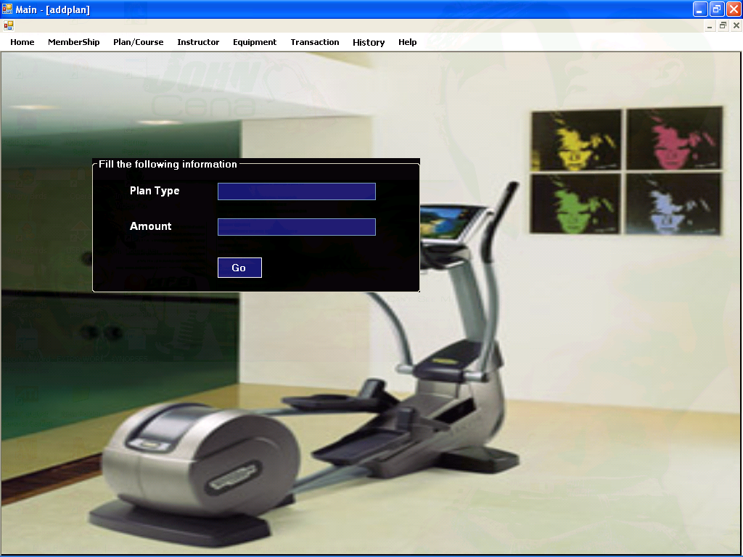

Slide 8
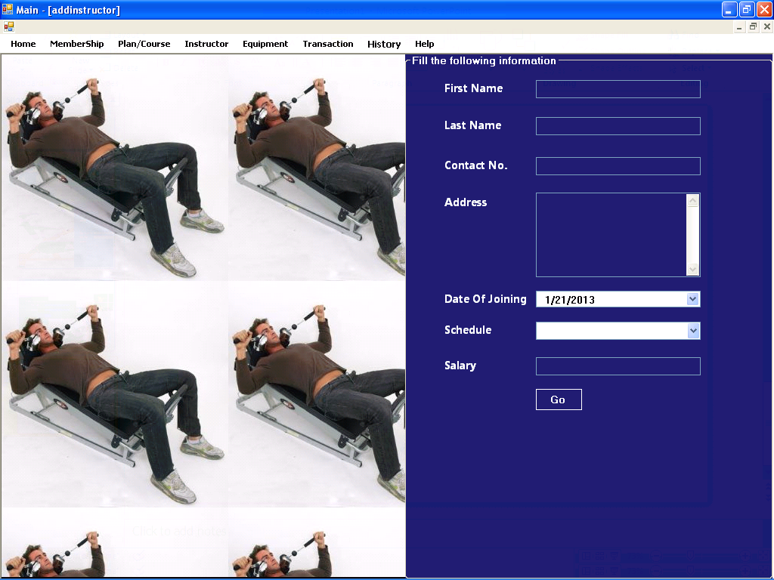

Slide 9
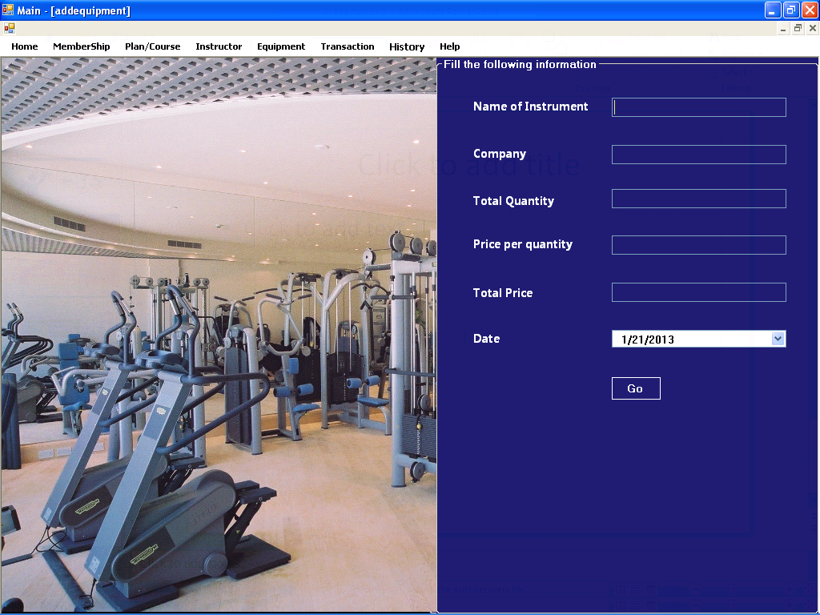

Slide 10
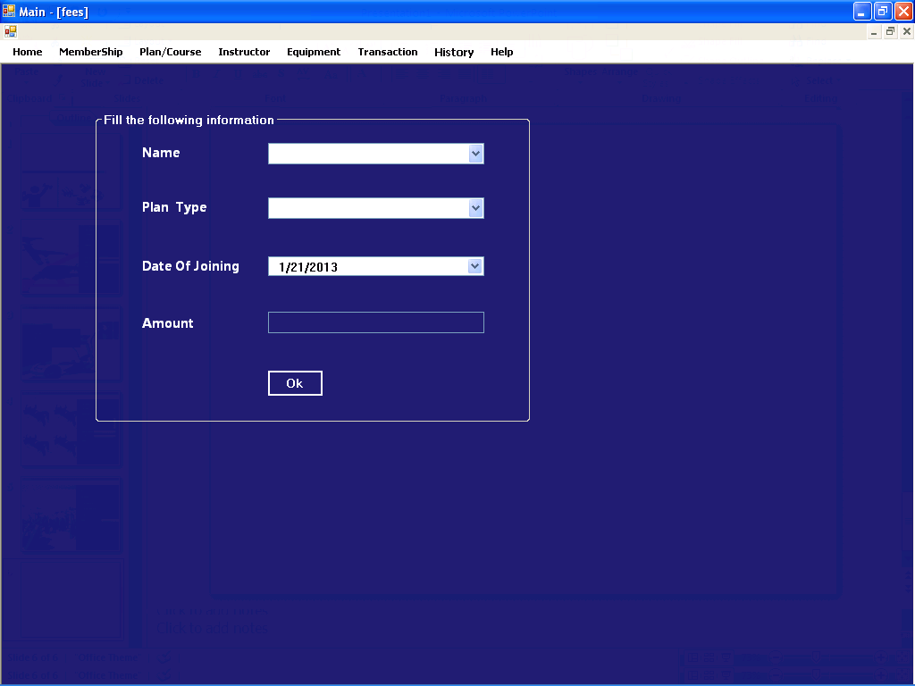

Slide 11
Data Flow Diagram
Database
Software
User

Slide 12
DFD-User
User Accounts
Account
Plan Details
Course
User
Transaction Details
Transaction
Schedule
Schedule

Slide 13
Hardware Configuration
Processor : Pentium III 630MHz(Minimum)
RAM : 128 MB
Hard Disk : 20GB (Minimum)
Monitor : 15” Color monitor
Key Board : 122 Keys

Slide 14
Software Configuration
Operating System : Windows NT,
Windows 98,
Windows XP.
Language : ASP.NET
Database : MS Access2007.

Slide 15
References
Programming in C#,
Programming ASP.NET
ASP.NET Visual C#.NET,
Using Microsoft Access.

Slide 16
Conclusion
Our project is only a humble venture to satisfy the needs of the Gym.
Several user friendly coding have also been adopted.
This package shall prove to be a powerful package in satisfying all the requirements of the respective organization.

Slide 17
Thank You..for your
co-operation….

